Slide 1

Sql project
GDg: GOOGLE DEVELOPERS GROUP
Omar fayez abdelaziz

Slide 2
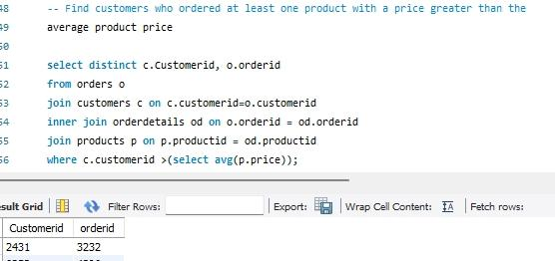
Find customers who ordered at least one product with a price greater than the average product price

Slide 3
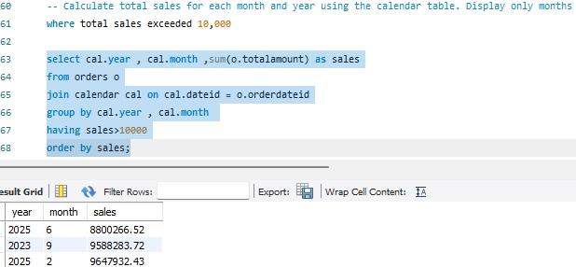
Calculate total sales for each month and year displaying where total sales>10000

Slide 4
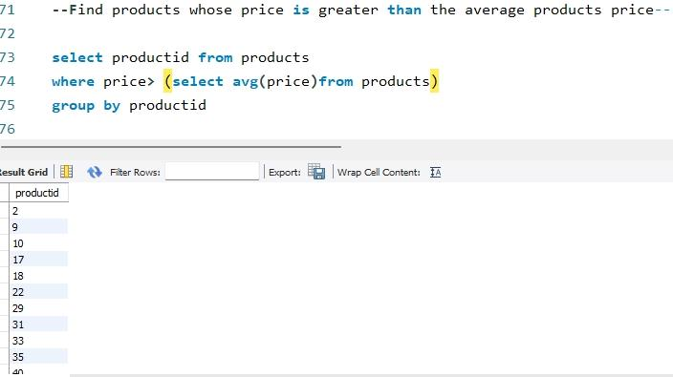
Find products whose price is greater than the average

Slide 5
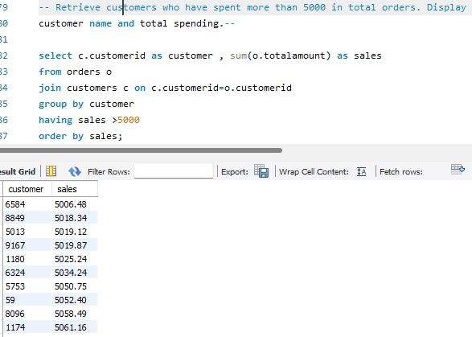
Retrieve customers who have spent more than 5000 in total orders. Display customer name and total spending

Slide 6
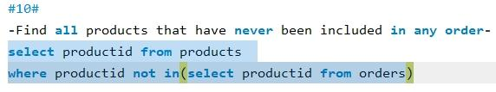
Find all products that have never been included in any order

Slide 7
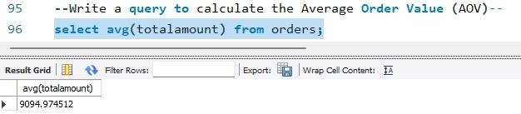
Calculate the average order value

Slide 8
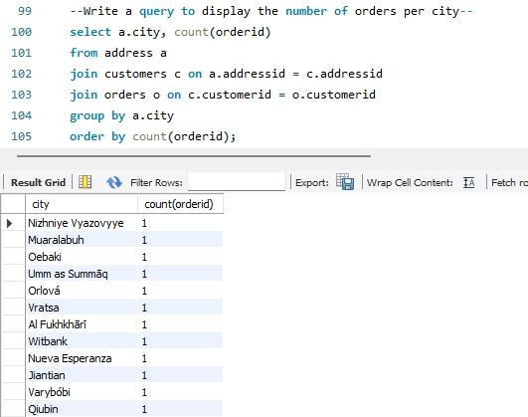
Write a query to display the number of orders per city

Slide 9
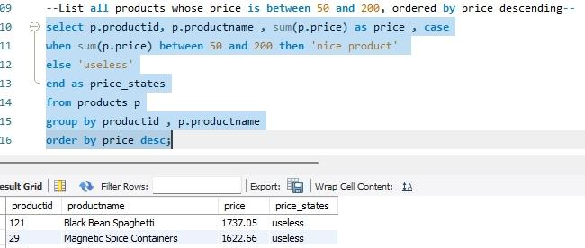
List all products whose price is between 50 and 200, ordered by price descending

Slide 10
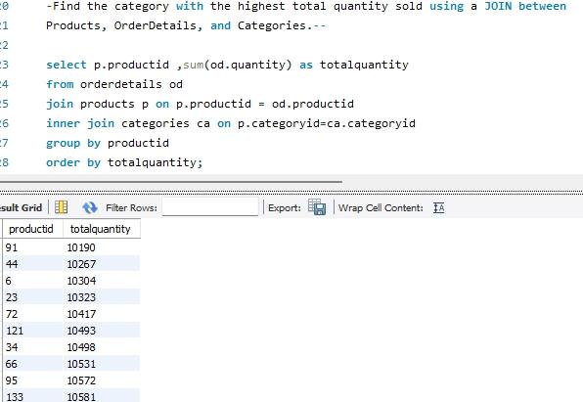
-Find the category with the highest total quantity sold using a JOIN between Products, OrderDetails, and Categories.

Slide 11
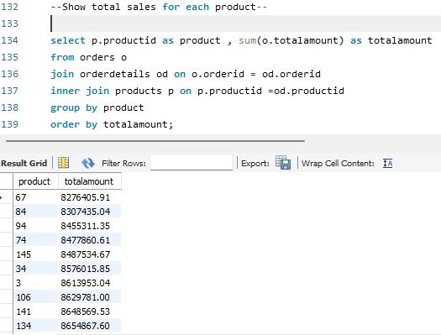
Show total sales for each product

Slide 12
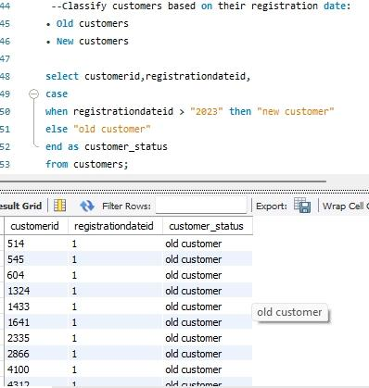
Classify customers based on their registration date: • Old customers • New customers

Slide 13
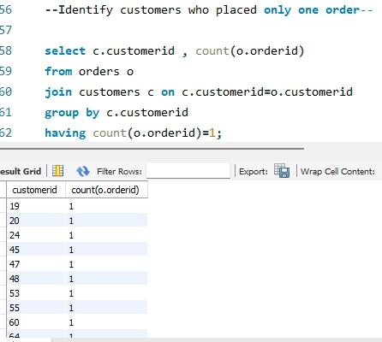
Identify customers who placed only one order

Slide 14
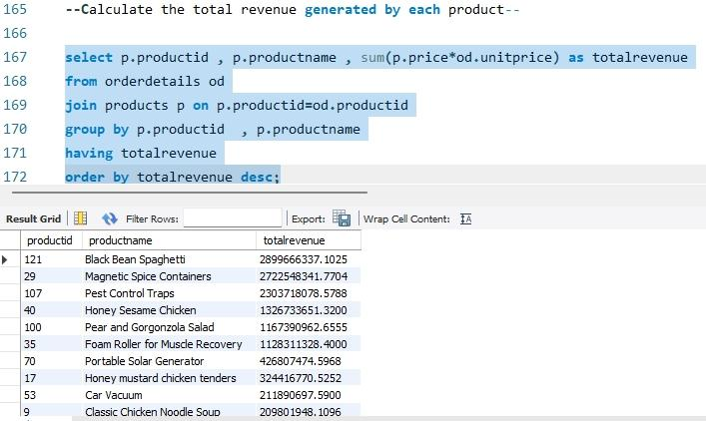
Calculate the total revenue generated by each product.

Slide 15
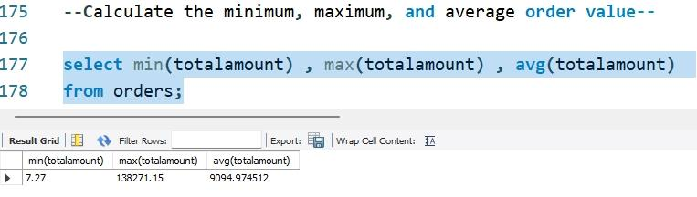
Calculate the minimum, maximum, and average order value.

Slide 16
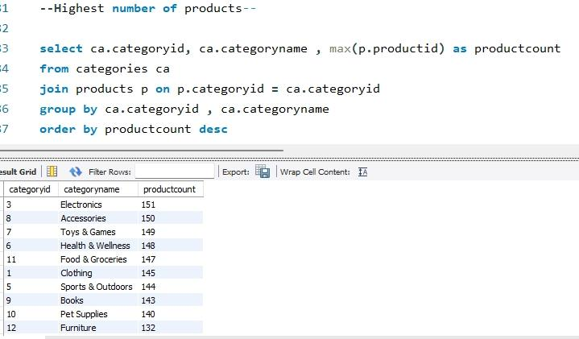
Highest number of products

Slide 17
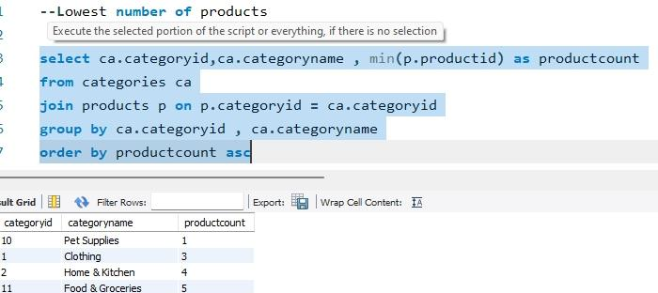
Lowest number of products

Slide 18
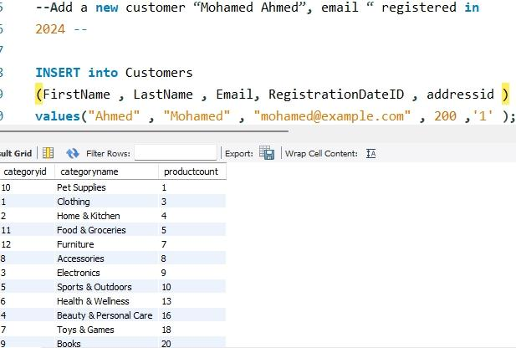
Add a new customer “Mohamed Ahmed”, email “ registered in 2024

Slide 19
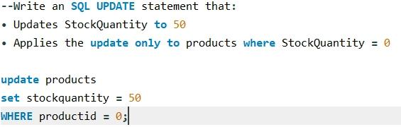
Write an SQL UPDATE statement that: • Updates StockQuantity to 50 • Applies the update only to products where StockQuantity = 0

Slide 20
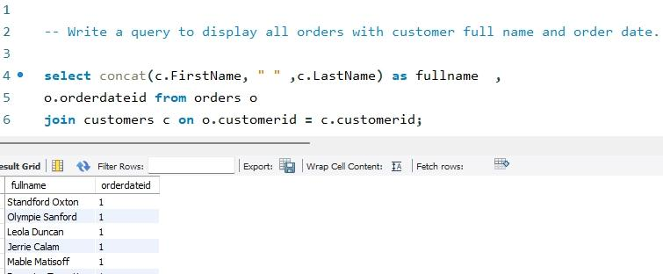
Write a query to display all orders with customer full name and order date.

Slide 21
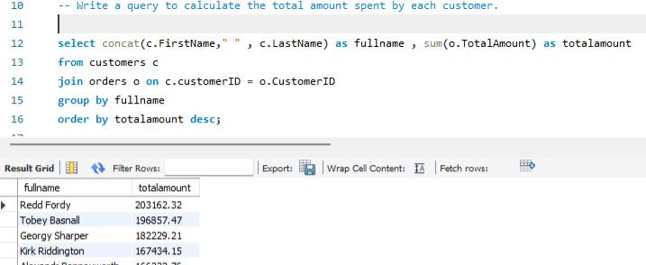
Write a query to calculate the total amount spent by each customer.

Slide 22
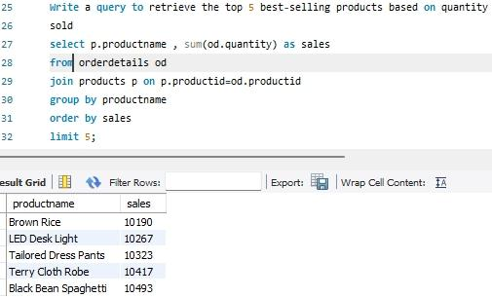
Write a query to retrieve the top 5 best-selling products based on quantity sold

Slide 23
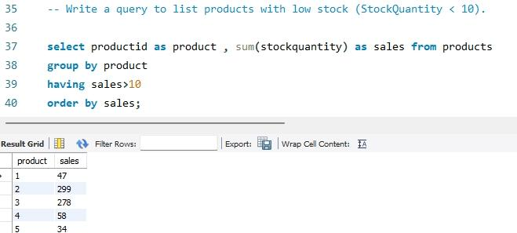
Write a query to list products with low stock (StockQuantity < 10).

Slide 24
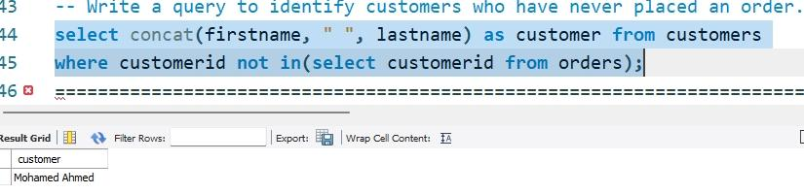
Write a query to identify customers who have never placed an order.

Slide 25
Project summary
24 SQL queries Data analysis using MySQL Business insights from sales database
Joins (INNER JOIN) Aggregations (SUM, AVG, COUNT) Subqueries Filtering (WHERE, BETWEEN) GROUP BY & HAVING ORDER BY CASE Statements INSERT & UPDATE

